Slide 1
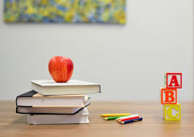
When is your birthday?
English lesson for the 5th grade

Slide 2
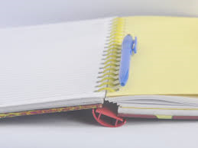
Let`s check the homework
Describe people from your family.

Slide 3
The verb have got
I have got a sister.
I haven`t got a brother.
Have I got a big family?
He has got a brother.
He hasn`t got a sister.
Has he got a big family?

Slide 4
Speaking
What month is today?
What month is tomorrow?
What season is now?

Slide 5
Textbook
Pages 42-43

Slide 6
Star signs – textbook – page 140
Aquarius /əˈkweəriəs/ водолей
Pisces /ˈpaɪsiːz/ риби
Aries /ˈeəriːz/ овен
Taurus /ˈtɔːrəs/ телец
Gemini /ˈdʒemɪni/ близнаци
Cancer /ˈkænsə/ рак
Leo /ˈliːəʊ/ лъв
Virgo /ˈvɜːɡəʊ/ дева
Libra /ˈliːbrə/ везни
Scorpio /ˈskɔːpiəʊ/ скорпион
Sagittarius /ˌsædʒɪˈteəriəs/ стрелец
Capricorn /ˈkæprɪkɔːn/ козирог

Slide 7
Ordinal numbers
1st first
2nd second
3rd third
4th fourth
5th fifth
6th sixth
7th seventh
8th eighth
9th ninth
10th tenth
11th eleventh
12th twelfth
20th twentieth
21st twenty-first

Slide 8
Homework
Exercise the new words.

